Slide 1
PROTECTING Intellectual property
Importance for Entrepreneurs and New Ventures

Slide 2
Today
Property, and IP
Trade Secret
Copyright
Trademark
Patent
Summary / Comparison
Example – new product

Slide 3
Property
What is it?
a thing or things belonging to someone; possessions collectively.
the right to the possession, use, or disposal of something; ownership; right to exclude.

Slide 4
Property
Real property
Fixed; mainly land and buildings
Personal property
Movable; belongings
Intellectual property
creations of the mind for which a monopoly is granted by law, for a limited time.
What types of creation?

Slide 5
Creations
Artistic works including music and literature,
discoveries, inventions,
words, phrases, symbols, designs, and images used in commerce

Slide 6
Balancing Act
By striking the right balance between the interests of innovators and the wider public interest, the IP system aims to foster an environment in which creativity and innovation can flourish.

Slide 7
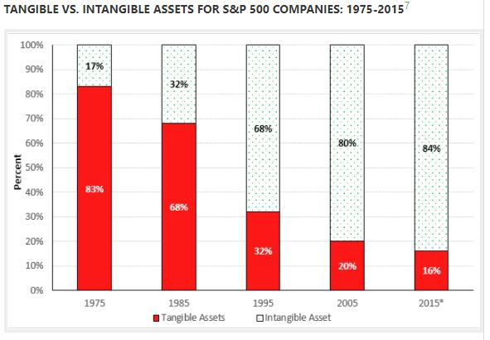
Tangible vs Intangible assets
7 “Annual Study of Intangible Asset Market Value” from Ocean Tomo, LLC, March 4, 2015. The percentage is calculated by subtracting
tangible book value from market capitalization.

Slide 8
The big 4
Trade Secret
Copyright
Trademark
Patent

Slide 9
Trade Secret
a formula, practice, process, design, instrument, pattern, commercial method, or compilation of information not generally known or reasonably ascertainable by others
by which a business can obtain a competitive advantage

Slide 10
Trade Secret
Examples
Customer lists
Product formula
Invention (at least initially)

Slide 11
Trade Secret
Some well-known examples (motivations & techniques)
Google search algorithm
Avoid gaming system (SEO industry)
KFC recipe
2 separate companies blend portions
Coca-cola
2006 espionage Pepsi
NYT Bestseller list
Twinkies
Chemicals

Slide 12
Trade Secret
How to protect them?
Internal safeguards
Need-to-know
Physical measures
Premises
Physical access
IT equipment / encryption
Nondisclosure agreements
Employees
Collaborators
Customers
Investors
Non-compete agreements
Employees

Slide 13
Copyright
the exclusive legal right of an originator to print, publish, perform, film, or record literary, artistic, or musical material, and to authorize others to do the same
Protection starts as soon as in tangible form

Slide 14
Copyright – types of works
Literary works
Books, speeches (recorded), manuals, software
Music
Published
Derivative works
E.g., song performance
Movie based on a book (Ben Hur)
Dramatic works
Play, movie, newscast, television show
Pantomime, choreographic works
Pictorial, graphic, sculptural works
Architectural works

Slide 15
Copyright
What is not copyrightable?
Facts
Idea
vs. expression of it
Example – indoor shrimp farm
Business plan; franchise agreement
Titles
Recipes
Fashion (if separable)

Slide 16
Copyright
Best practices
© (notice)
Register
Protective measures
Software – embed unused info
Map – fake street or two
Understand fair use
Criticism, comment, education, parody

Slide 17
Copyright
Goldieblox and the Beastie Boys
Startup company, encourage girls in STEM
Construction toys
Video (viral) based on Beastie Boys “Girls”, w/o permission
Beastie Boys: stop; music not to be used for products
Goldieblox – sued; defense: parody. Lost.
Eventual settlement: $1M (to charity)

Slide 18
Trademark
A word, name, symbol, sign, design which distinguishes the origin of a product or service from others

Slide 19
Trademark
Words
Coke
Barbie
Nike
Phoenix University

Slide 20
Trademark
Slogans
Just Do It
You’re in Good Hands with Allstate
Don’t Leave Home without It

Slide 21
Trademark
Acronyms
IBM
USPS
NBA
ASU

Slide 22
Trademark
Numbers
501 (jeans)
V-8
747

Slide 23
Trademark
Symbols / Logos

Slide 24
Trademark
Colors
Brown (UPS)
Pink (Owens-Corning Fiberglass)

Slide 25
Trademark
Sounds
“Roar” - MGM lion
“D’oh!” - Homer Simpson
5 tones - Intel Inside

Slide 26
Trademark
When does protection start?
Once in commercial use
But limited
Preferably, seek federal registration
Word/slogan/etc.
Description of Goods or Services
Search first
Avoid infringement
Avoid re-branding

Slide 27
Trademark
A spectrum of trademark strengths:
Running Shoes
Photo Sharing
Service
Honey Roasted
Peanuts
Bed & Breakfast
Registry
Greyhound
Snapchat
Coppertone
Apple
Exxon
Xerox

Slide 28
TrademarkTM
TM
Once in use, or
Application filed
®
Upon federal Registration

Slide 29
Patents
Ideas, concepts embodied in machines, structures, processes & compositions
Right to exclude others from
Making,
Using, or
Selling your invention

Slide 30
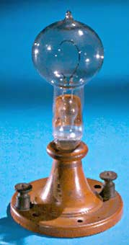
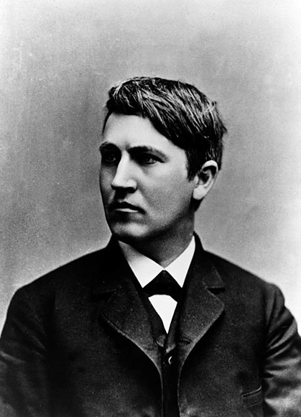
Right to Exclude

Slide 31
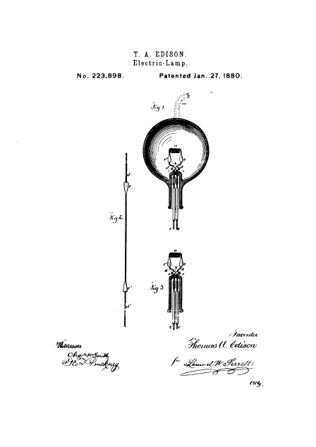

Slide 32
Right to Exclude
US 223,898 (Edison) – Claim 1
“An electric lamp for giving light by incandescence, consisting of a filament of carbon of high resistance”.
Subsequent inventor
Invents improved light, having a graphite filament
Obtains a patent for electric lamp with graphite filament
Can inventor-2 sell graphite-filament light bulbs?
Only if licensed by Edison; royalties
Can inventor-2 exclude others from selling graphite-filament light bulbs?
yes

Slide 33
“The patent system adds the fuel of interest to the fire of genius”
Abraham Lincoln

Slide 34
Patents
How
Search
Products
Prior patents
Prepare/file patent application
“Patent pending”
Get professional help (avoid landmines)
Examined
And hopefully, eventually, approved

Slide 35
Patents
Where
In each country in which protection is desired
Business decision, based on
Where is your market
Where is your product manufactured
Where is your competition
How many filings per year?

Slide 36
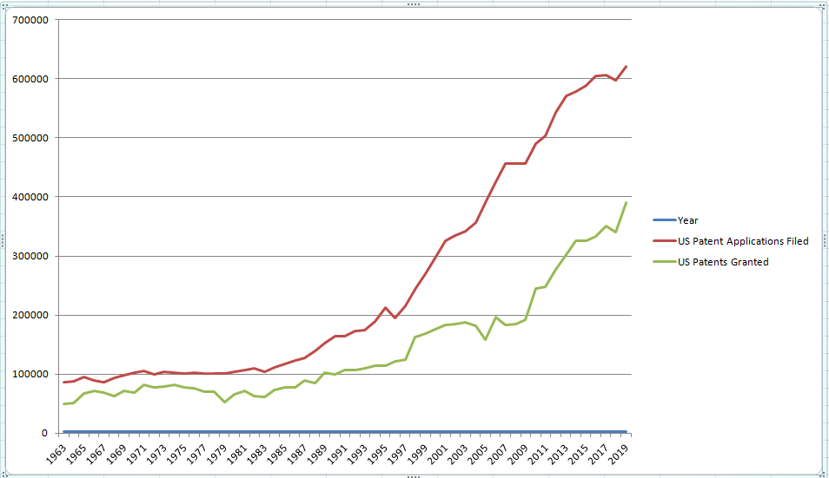
Patents
US Patent Filings, and Granted Patents – 1963 - 2019

Slide 37
Patents
Goals - Why obtain patents?

Slide 38
Patents
Goals (Why obtain patents)
Maintain or Expand Market
prevent copying
reduce competition
Improve profit
Increase value of company
investors/venture capital, esp. start-ups
Protect investment
Establish credibility
Demonstrative innovativeness
Show belief in competitive advantage

Slide 39
Patents
Goals (cont’d)
Collect royalties
Exclusive or non-exclusive license
Freedom of action
cross licensing
bargaining chips to reduce or eliminate royalties to others
Protect investment in R&D

Slide 40
Patents
Goals (cont’d)
Recognition / Marketing
business, technical, public relations
Inventors
Discourage infringement suits
valuable
ave. US infringement legal cost = $500K and up
diversion of management/company resources
possibility of $M damages, or shut down product line

Slide 41
Patentability
What is patentable
New and useful process, machine, article of manufacture, or composition = Novelty
Non-obvious to a person of ordinary skill in the art
Software, Business Methods (limited)
What is not patentable
Laws of nature, Physical phenomena, Scientific truth, abstract ideas
isolated DNA sequence as of June 2013 US Supreme Ct. decision – “cDNA” (synthesized) only

Slide 42
Patentability
When must a patent application be filed?
Relative to public disclosure, use, or sale of the invention?
Outside the US – must file first
In US – 1-year “grace period” (limited)
Early Filing Date can in any event be crucial
Others might have same idea

Slide 43
Patents
Provisional vs Utility applications
Utility = a full, regular patent application
Description + Drawings + Claims
Is examined
“Patent pending”
Cannot be changed after filing

Slide 44
Patents
Provisional vs Utility applications
Provisional – useful in some situations
Description + Drawings
Somewhat cheaper, faster
Get early filing date – holding place
Also “Patent pending”
Can include later improvements if within 1 year
Is not examined
Still need utility applic within 1 year

Slide 45
Summary / Comparison
 | Gov’t approval? | DIY? | Cost | Time to approval
Trade Secret | No | Yes | Variable (internal controls & agreements) | n/a
Copyright | Not initially, but registration recommended | Yes (simple form and fee) | $35 | 6-8 mos.
Trademark | Not initially, but registration recommended | Maybe (35% currently) | $2K-3K | 1 year
Patent | Required | No | $10K-15K+ | 2 years (ave.)

Slide 46
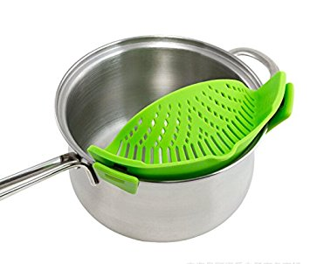
New product – how protect IP?
A strainer, for straining water after boiling vegetables, pasta, etc.

Slide 47
New product – how protect IP?
Hypothetically
Assume product is not on the market
Inventor wants to start a business to make/sell product
Plans promotional Youtube video
Innovations:
1-handed water straining
way it attaches to pot
new material
new plastic formulation
Flexible
withstands boiling water temperature

Slide 48
New product – how protect IP?
Trade Secret?
Potentially, the new material, and/or how it is made
May be able to be kept secret
But – reverse engineer?
Also, difficult to license

Slide 49
New product – how protect IP?
Copyright?
Youtube video
As soon as it is produced
register

Slide 50
New product – how protect IP?
Trademark?
Name
Brainstorm/search
Not too descriptive
E.g., ‘Pasta Strainer’, ‘Veggie Strainer’
Preferably, suggestive of some characteristic
E.g., ‘EZStrain’, ‘PanGripper’, ‘StrainSafe’
Slogan
As used in promo video, packaging

Slide 51
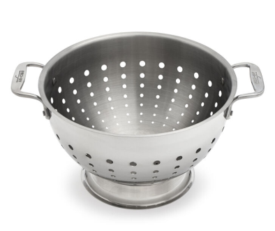
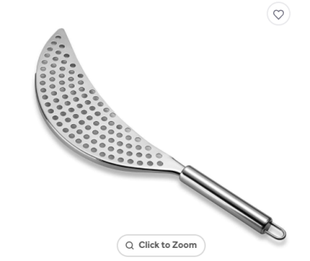
New product – how protect IP?
Patent?
Search for ‘prior art’
E.g.,
Prepare/file application
Emphasis: shape, r’ship to pan, clips
And how clips integrate with strainer
Also – new material, how it’s made
Instead of trade secret

Slide 52
Contact information
Steve Ackerman
stevea@saileackerman.com
Saile Ackerman LLC, Poughkeepsie NY
(845) 452-5863
www.saileackerman.com
Disclaimer: The materials available in this slide deck and discussed in the webinar are for informational purposes only and not for the purpose of providing legal advice. You should contact Steve Ackerman, or another attorney, to obtain advice with respect to any particular issue or problem. Use of and access to this material does not create an attorney-client relationship between Saile Ackerman LLC and the user.

